Slide 1
ECE 385 – Digital Systems Laboratory
Lecture 6 – Lab 6: CPU Design
Chushan Li
FALL 2021
Link to Course Website
Notes:
ECE Main Slide

Slide 2
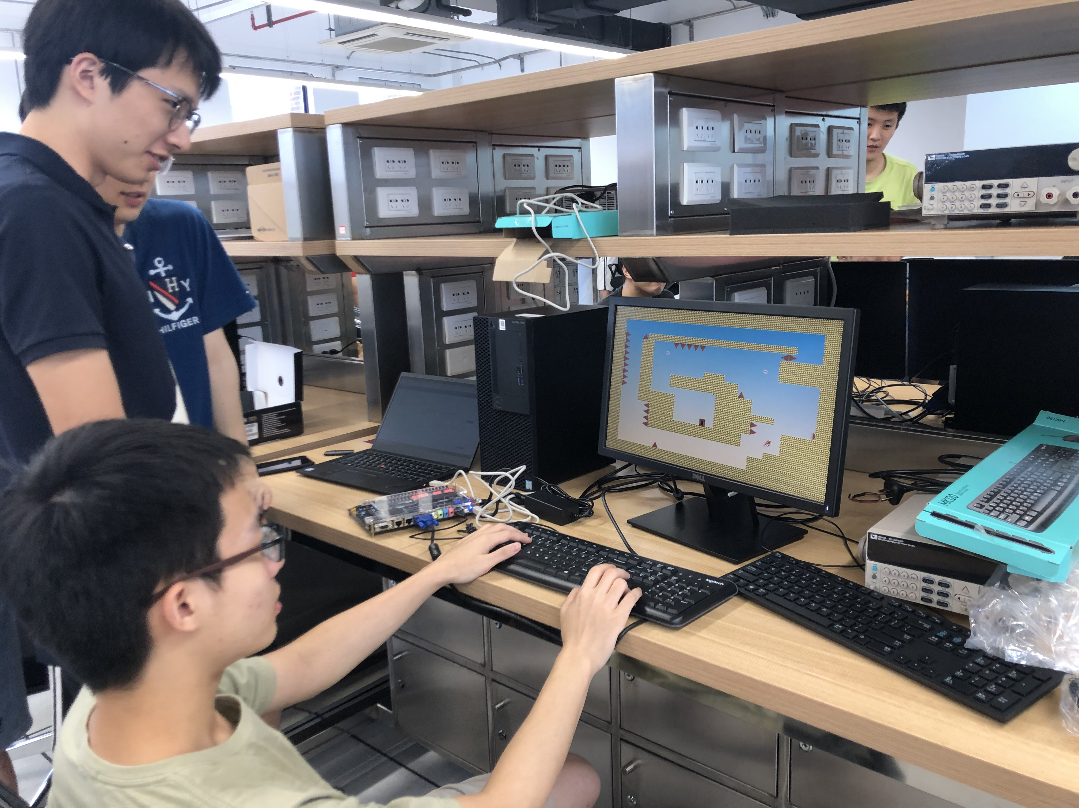
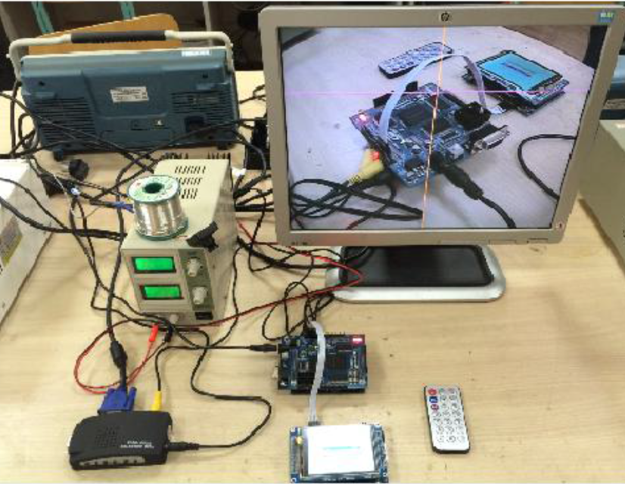
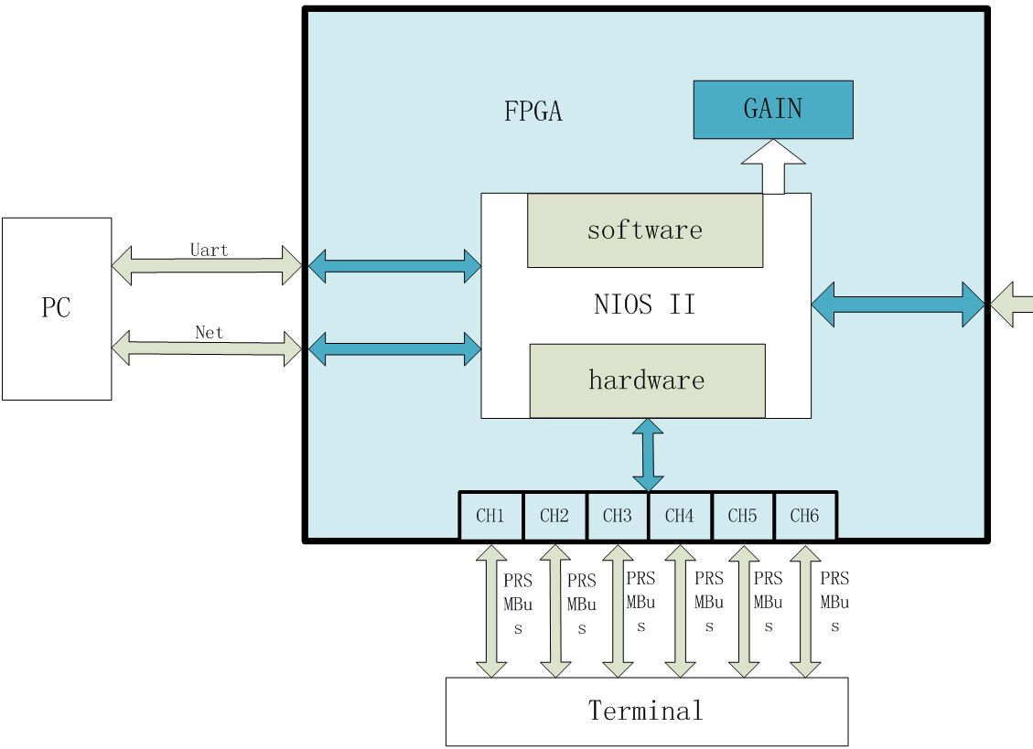
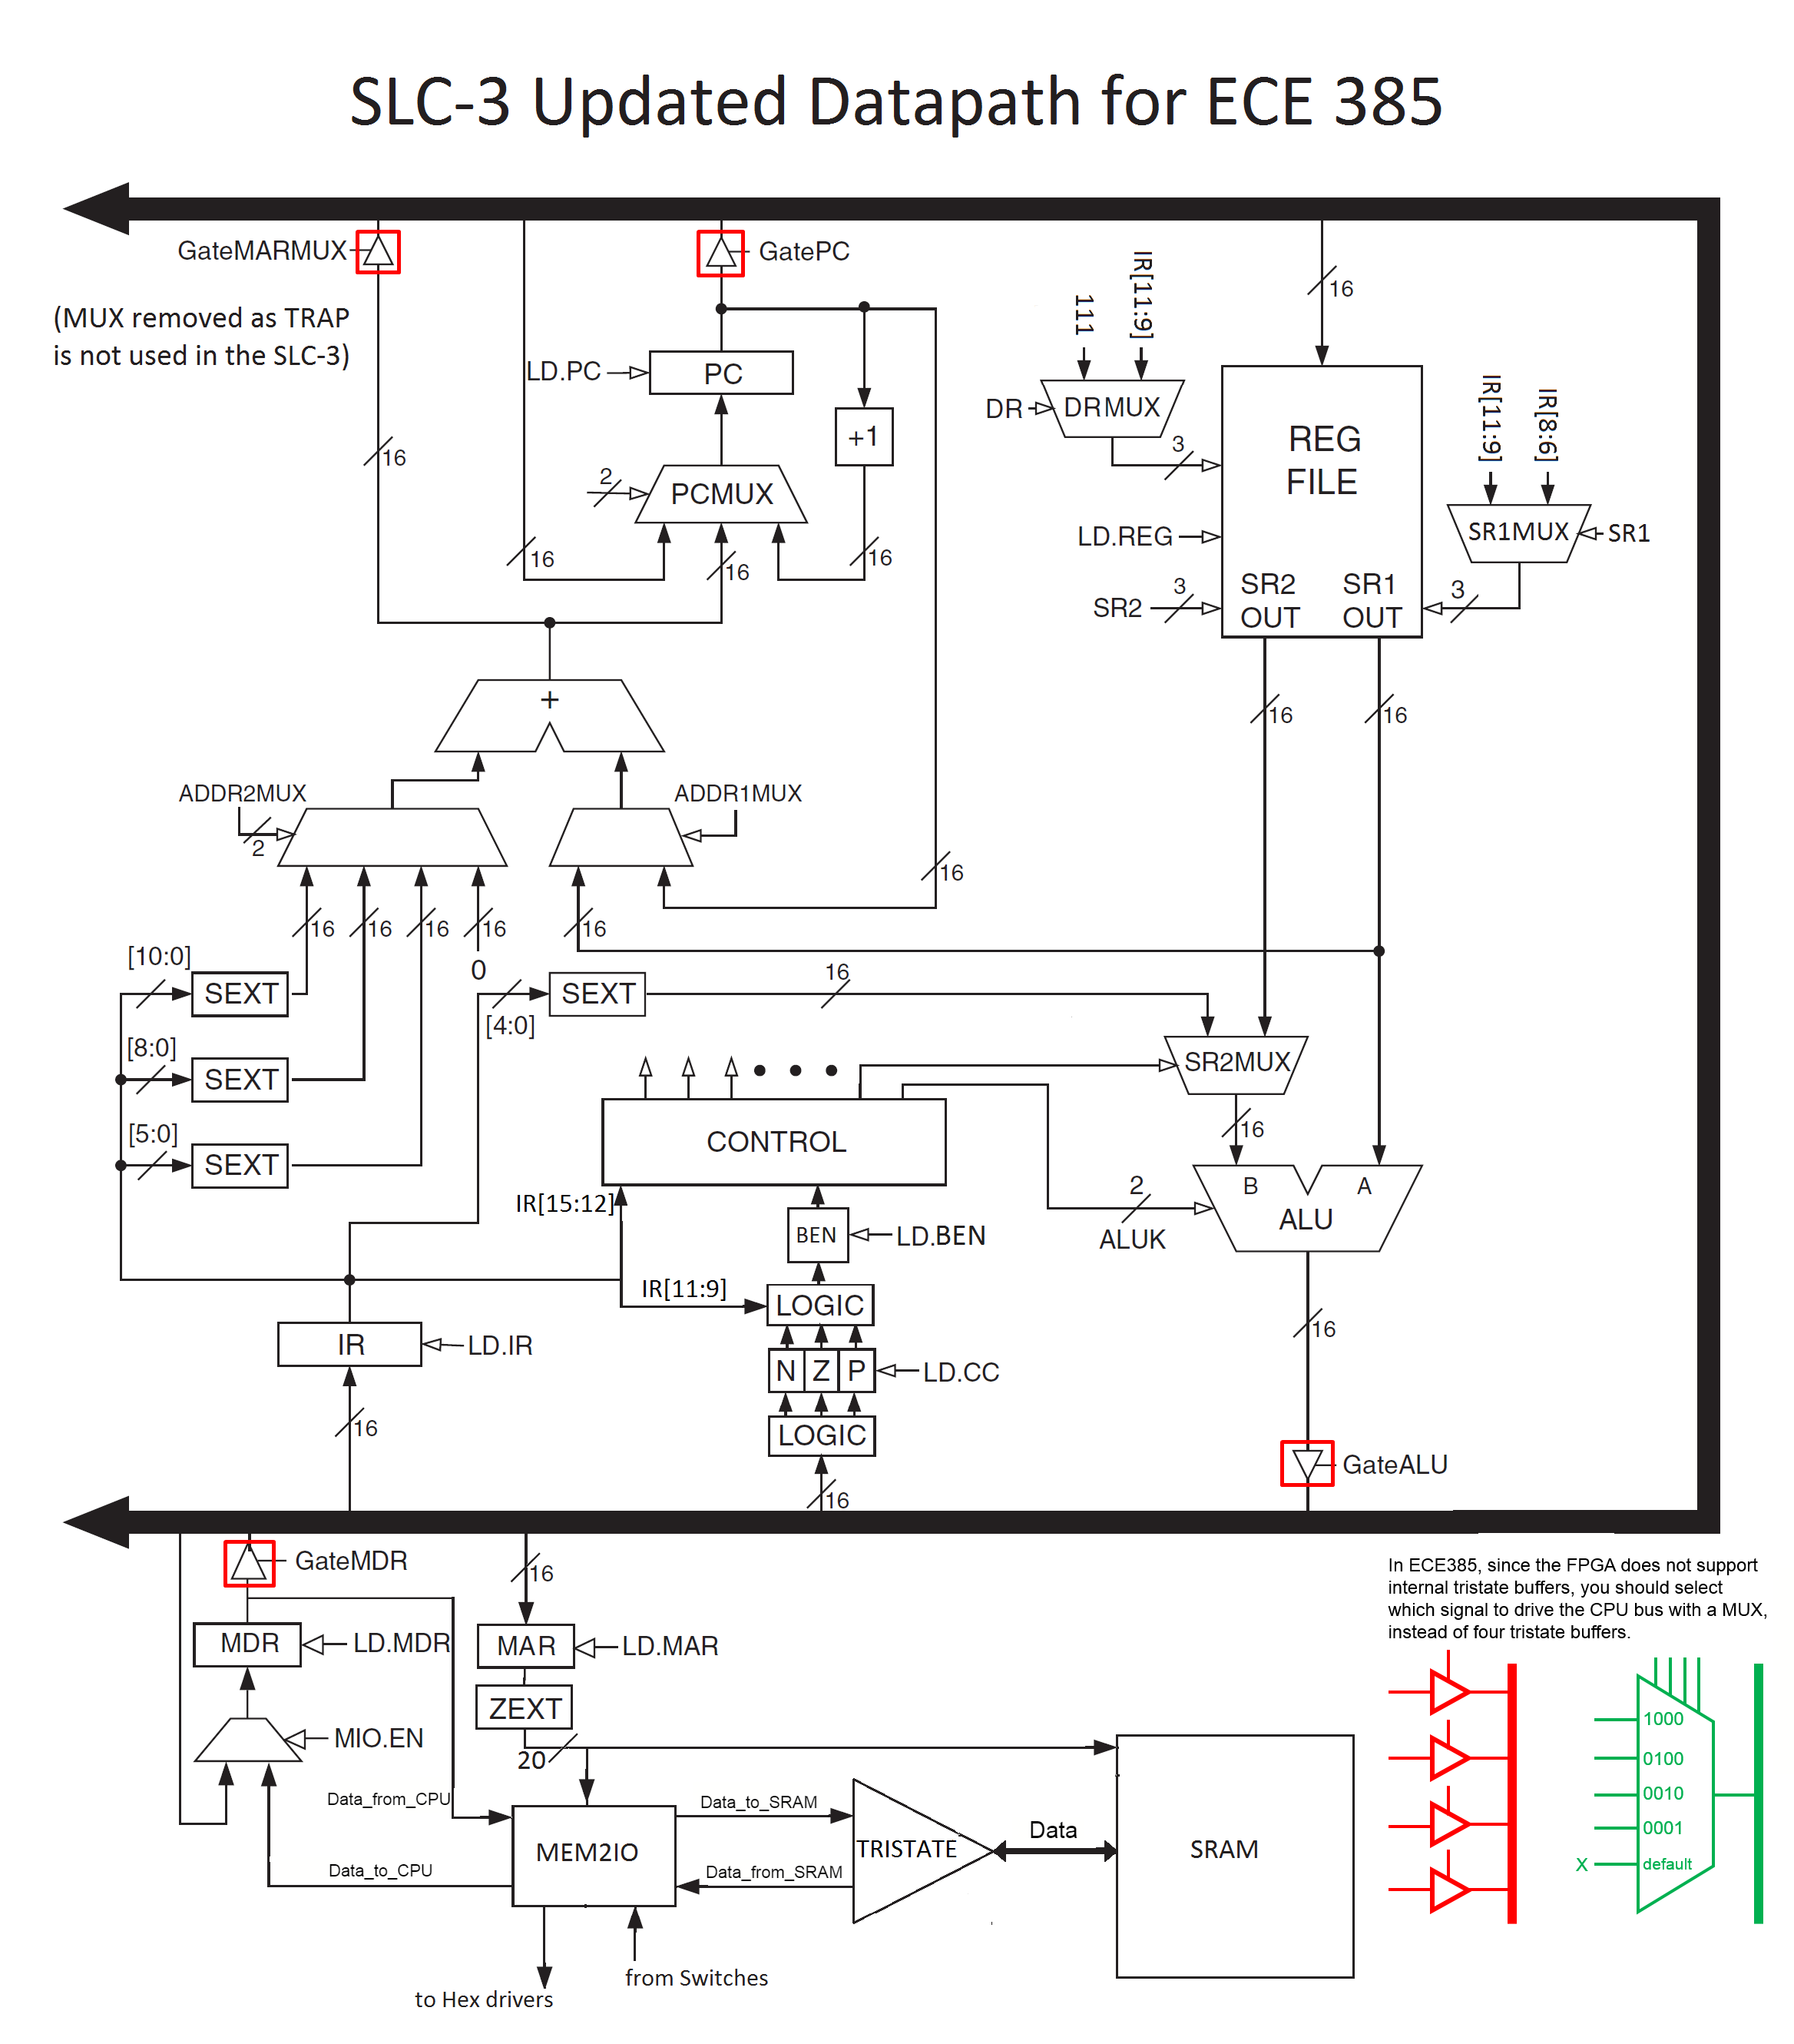
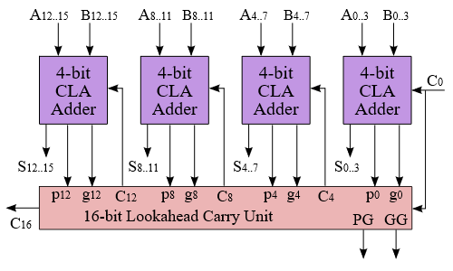
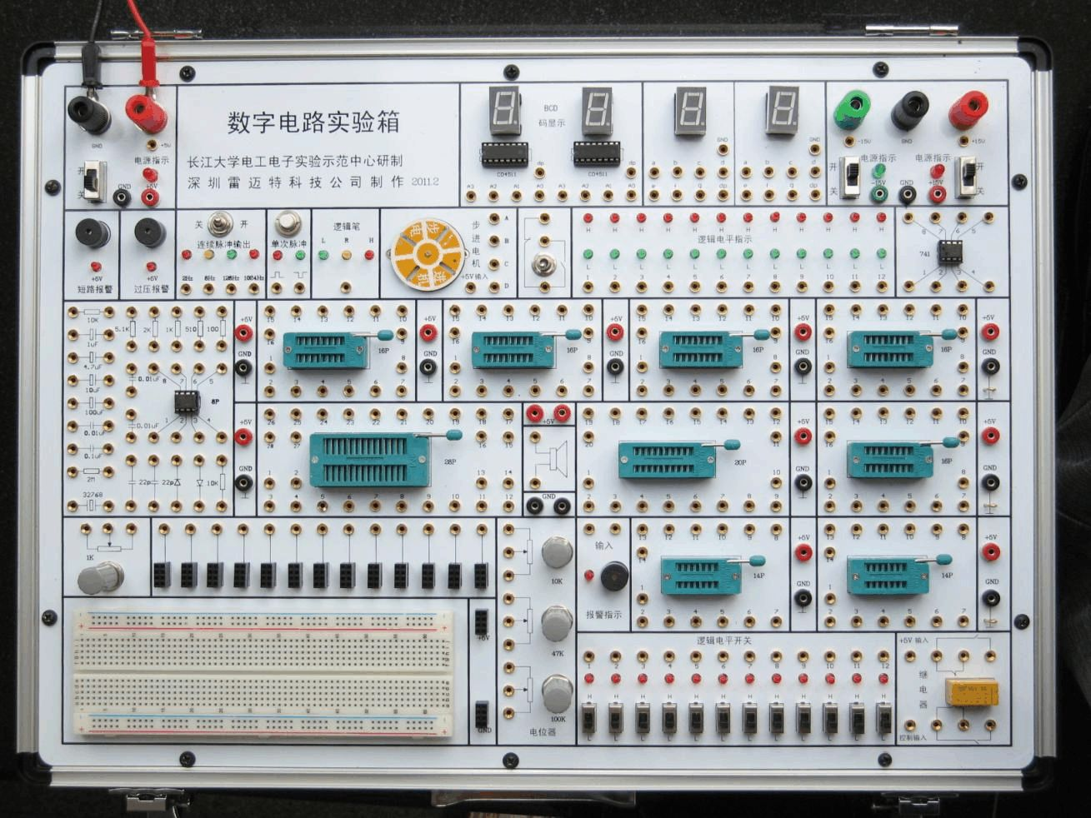
About ECE 385 & Lab 6
ECE 385 Digital Systems Laboratory is a lab course, but not a lab-only course
In each week,
2 hours lecture: basic concept in digital system design
+ around 9 hours after class programming
+ 3 hours in Lab testing and demo
Lab1-3: TTL circuit based design, to get familiar with digital system and traditional design method
Lab4-5: Adder and Multiplier design: to learn the circuit module design in FPGA, using SystemVerilog
Lab6: LC3 CPU design: to learn how to construct basic CPU in FPGA
Lab7: System with Nois II Core: SoC design introduction
Lab8-9: USB keyboard, VGA display and customized modules: interface with outside equipment
Final Project: Game Controller, 3D Processor, whatever you want to design

Slide 3
SLC-3 Block Diagram
Combinational Logic Circuit
Sequential Logic Circuit
Your key task:
Program the state machine in control block, realize the whole instructions set!
Where is the data flow?
How to control the datapath?
Notes:
Note, big bold line is the 16-bit CPU bus. There is only a single bus, MUXes and load-enables control at every cycle what gets loaded

Slide 4
SLC-3 ISA – Subset of LC-3 ISA
Before the control design, how to interpret these instructions?
Let take ADD R2, R1, R0 @0x3000 as an example to show the data flow and the control of all bits!
ADD R2, R1, R0 @0x3000
ADD: 0001
DR: R2 (010)
SR1: R1 (001)
SR2： R0 (000)
IR Address: 0x3000
0001 010 001 000 000 @0x3000
Notes:
Note: NZP appears twice. Lower case nzp is value of register, upper case NZP is value from IR

Slide 5
Partial State Diagram
State 18: Fetch_1
Current State: PC=0x3000
LD.MAR=1
LD.PC=1
PCMUX=10 (PC++);
GatePC=1;
After State 18: Fetch_1
PC=0x3001
MAR=0x3000
Notes:
For week 1, focus on first 3 states
Week 2 will have you make the rest of the states
Note how we wait for R, R is ready signal from memory
In practice, SRAM is fast compared to our 50MHz clock, so just wait extra cycle for read

Slide 6
Partial State Diagram
State 33: Fetch_2
Current State: MAR=0x3000
LD.MDR=1
MIO.EN=1
CE, OE=1
After State 33: Fetch_2
MDR=0001 010 001 000 000 (ADD R2, R1, R0 )
Notes:
For week 1, focus on first 3 states
Week 2 will have you make the rest of the states
Note how we wait for R, R is ready signal from memory
In practice, SRAM is fast compared to our 50MHz clock, so just wait extra cycle for read

Slide 7
Partial State Diagram
State 35: Fetch_3
Current State: MDR=0001 010 001 000 000
GateMDR=1
LD.IR=1
After State 35: Fetch_3
IR=0001 010 001 000 000 (ADD R2, R1, R0 )
Notes:
For week 1, focus on first 3 states
Week 2 will have you make the rest of the states
Note how we wait for R, R is ready signal from memory
In practice, SRAM is fast compared to our 50MHz clock, so just wait extra cycle for read

Slide 8
Partial State Diagram
State 32: Decode
Current State: IR=0001 010 001 000 000
Case (IR[15:12])
0001: NextState= 1 (ADD)
LD.BEN=1
After State 32: Decode
BEN is loaded, but not used here because next operation is ADD
Notes:
For week 1, focus on first 3 states
Week 2 will have you make the rest of the states
Note how we wait for R, R is ready signal from memory
In practice, SRAM is fast compared to our 50MHz clock, so just wait extra cycle for read

Slide 9
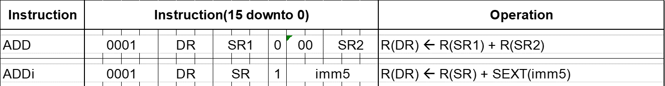
Partial State Diagram
State 1: ADD(Execution)
Current State: IR=0001 010 001 000 000
DRMux=0 (IR[11:9], R2:010)
SR2Mux=0 (SR2 Reg)
SR1Mux=0 (IR[8:6], R1:001)
SR2: IR[2:0], R0:000
ALUKMux=0 (ADD)
GateALU=1
LD.REG=1, LD.CC=1
After State 1: ADD(Execution)
NZP Reg is loaded, DR is loaded
Notes:
For week 1, focus on first 3 states
Week 2 will have you make the rest of the states
Note how we wait for R, R is ready signal from memory
In practice, SRAM is fast compared to our 50MHz clock, so just wait extra cycle for read

Slide 10
Understanding the data flow and control bits setting for all Instruction Cycle
My advice:
Print out ~10 copies of SLC block diagram
With different colored highlighter, trace out direction each MUX goes for each clock cycle in FETCH, DECODE and EXECUTE
FETCH should be common for all instructions
DECODE & EXECUTE will be different depending on instruction, start with a blank copy of block diagram and decide the DECODE & EXECUTE cycles for each instruction

